Slide 1




0.19 Release
@RAPIDSai
https://github.com/rapidsai
https://rapids-goai.slack.com/join
https://rapids.ai
Notes:
https://rapids.ai/ https://github.com/rapidsai
https://docs.rapids.ai/overview

Slide 2
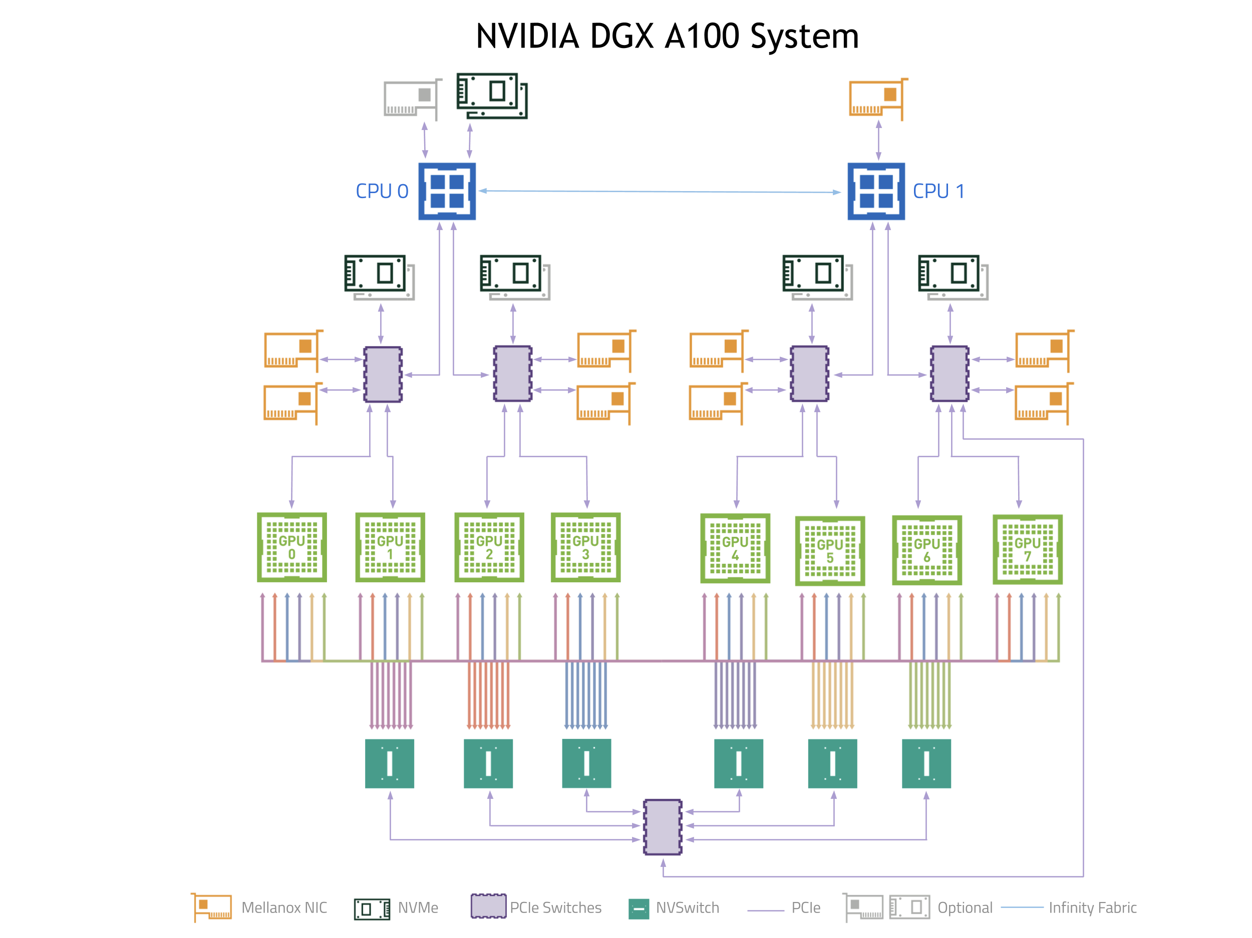
Why GPUs for Data Science?
Numerous hardware advantages
Thousands of cores with up to ~20 TeraFlops of general purpose compute performance
Up to 1.5 TB/s of memory bandwidth
Hardware interconnects for up to 600 GB/s bidirectional GPU <--> GPU bandwidth
Can scale up to 16x GPUs in a single node
Almost never run out of compute relative to memory bandwidth!

Slide 3
What is RAPIDS?
End-to-End GPU Accelerated Data Science
Data Preparation/ETL
Analytics/ML/Graph
Visualization
cuDF
GPU-accelerated ETL functions
Tracks pandas and other common PyData APIs
Dask + UCX integration for scaling
cuML
GPU-native ML library, including XGBoost, FIL, HPO, and more
cuGraph
GPU graph analytics, including TSP, PageRank, and more
cuxfilter
GPU-accelerated cross-filtering
pyViz integration
Plotly Dash, Bokeh, Datashader, HoloViews, hvPlot
Domain-Specific Libraries
CLX + Morpheus Cyber log processing + anomaly detection | cuSignal Signals processing | cuSpatial Spatial analytics
cuStreamz Streaming analytics | cuCIM Computer vision & image processing primitives | node-RAPIDS Bindings for node.js
...and more!

Slide 4
Overview of Changes: RAPIDS 0.19 Release
RAPIDS CUDA 11.2 now supported by all RAPIDS libraries; initial release of the new cuCIM library
RAPIDS+Dask Improved performance and memory spilling (JIT_UNSPILL), added capability to log spilling, improved UCX Debugging and Documentation, UCX 1.9 Support, RAPIDS Memory Manager(RMM) logging with Dask-CUDA
cuDF Support for fixed-point decimal types in Python; more groupby and rolling window aggregations; support for list type operations in Python; expanded dictionary type operations in C++;
cuML Scikit-learn-compatible preprocessing, Single Linkage Hierarchical Clustering Algorithm; SHAP explainability; improved Random Forest classification, improvements to forest inference, DBSCAN, kNN
XGBoost 1.4.0 ships with 0.19, including improvements to Dask integration and prediction functions
cuGraph new Random Walk; RMAT data generator; continued improving graph primitives for performance, work started on supporting multiple seeds for BFS, SSSP, and Egonet
CLX Sensitive information detection workflow and training script, crypto mining and GPU malware detection and training script, host introspection workflow and feedback prototype

Slide 5
cuDF Updates: Deep Dive
Release 0.19
Features added in 0.19
Decimal data type is now supported for joins, read_parquet, and column comparison functions in Python
Unique and sort functions for groupby aggregation are now available
Support for nested types such as lists and structs in Python and a Medium blog to elaborate it
Enhanced support for dictionary data types in C++
Planned Upcoming Features
Cumulative operations for groupby
Conditional Joins
ORC GDS Support
Decimal Type Support for ORC and CSV
Notes:
Medium blog title : Lookout, nested types are now supported in RAPIDS cuDF!

Slide 6
cuML Updates: Deep Dive
Release 0.19
Features added in 0.19
Scikit-learn compatible preprocessing - now no longer experimental - 10+ preprocessing methods
SHAP explainability - also ready for production - explain predictions of any cuML or sklearn model
New Random Forest backend for classification models - better performance and accuracy
New Single Linkage Hierarchical Clustering Algorithm
Logistic Regression accepts sample_weight parameter
predict_proba function is now available for XGBoost-style models in Forest Inference Library (FIL)
New distance metrics for Approximate Nearest Neighbors (ANN)
cuML integrated into AutoGluon
Planned Upcoming Features
New Random Forest backend will be expanded to support regression
Hierarchical Density-Based Spatial Clustering of Applications with Noise (HDBSCAN) algorithm
Fast Fourier Transform (FFT) accelerated t-Stochastic Neighborhood Embedding (t-SNE)

Slide 7
cuGraph Updates: Deep Dive
Release 0.19
Features added in 0.19
New sampling algorithm, Random walk
Improved performance of graph primitives on graphs with widely varying vertex degrees
Recursive Matrix graph data generator
Enhance graph partitioning scheme
Enhance multi-node multi-gpu Louvain
Planned Upcoming Features
Breadth First Search with depth limit functionality
Multi-Node Multi-GPU Weakly connected components
Batch Random Walk
Breadth First Search using multiple sources in a graph and in multiple graphs
Egonet extractor using multiple sources

Slide 8




Join the Conversation
GOOGLE GROUPS
DOCKER HUB
SLACK CHANNEL
STACK OVERFLOW
https://groups.google.com/forum/#!forum/rapidsai
https://hub.docker.com/r/rapidsai/rapidsai
https://rapids-goai.slack.com/join
https://stackoverflow.com/tags/rapids

Slide 9
THANK YOU
@RAPIDSai
Notes:
https://rapids.ai/ https://github.com/rapidsai
https://docs.rapids.ai/overview

